Slide 1
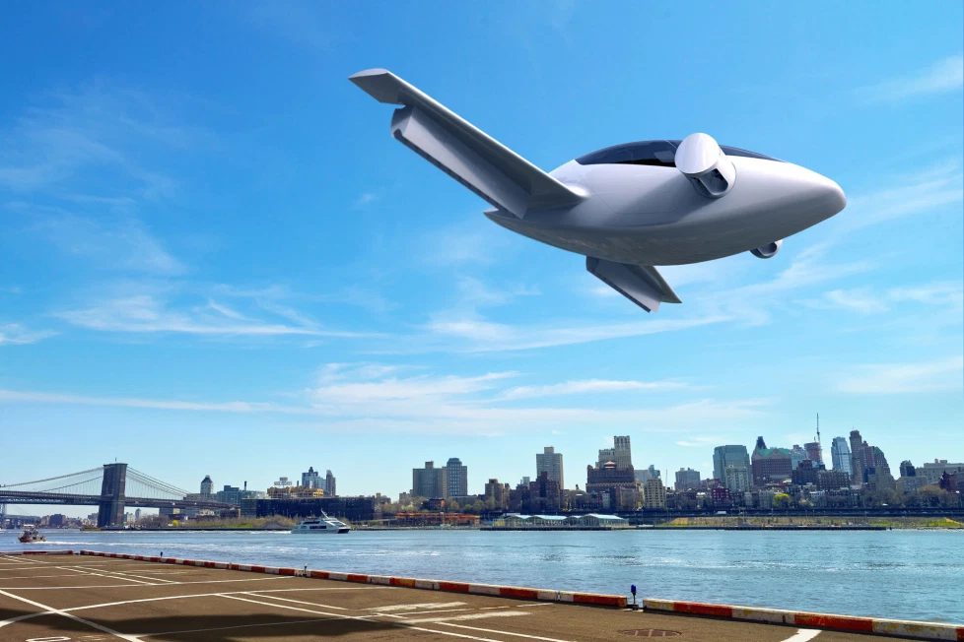
Flying Taxi
Launch Strategy
Francis Odo

Slide 2
Developing an MVP Launch Strategy for Flying Taxi Service

Slide 3
Data Exploration

Slide 4
Pain Points
Taxi is used for carrying a passenger to a short destination at the request of the passenger with no stop in-between
Typically, city residents, frequent air-travellers, residents that are out late at night, residents that want to avoid traffic and parking inconveniences
Traffic congestion leading to delays, Taxi-driver lateness, high cost of longer distance trip, Transportation infrastructure problems
High or Increased emission, traffic congestion,Security measure level is inadequate(driver and passenger)

Slide 5
Hypothesize Flying Taxi Service
User will spend less time travelling(faster) with a much smoother and quieter experience. Reduced emission with more environmentally compliant craft.
The Air Taxi will bring organized and better structure to the Taxi industry, as well as, Air Traffic Control. Mandatory professional licencing for Taxi Pilots, Standardized scheduling and security for passengers. With more people traveling by air to shorter destinations, the road will be less congested, which will ultimately lead to reduced road infrastructure spending

Slide 6
Exploring Taxi Pickup and Drop-off Data
There are 1048469 records (13 Features or Columns)
Each record represnts a Taxi pick-up and drop-off service
The primary key is the “id”, which indicates the service identification number
Data is bound to Jan 1, 2016 to Jul 2, 2016 date range
The geographical bounds extend beyound New York and New Jersey. Most data points are centralized in New York and New Jersey.
There are Outliers(New hamshire, Pensylvania, Virginia, North Carolina)

Slide 7
Scope and Distribution of Dimensions
Average Duration - 962
Median Duration - 662
1st Std. Dev. Duration - 5,853
2nd Std. Dev. Duration - 2*(5,853)=11,706
Ave. Distance - 3.442
Median Distance - 2.095
1st Std. Dev. Distance - 4.382
2nd Std. Dev Distance - 2*(4.382)=8.764
Ave. Passenger Count - 1.6644
Median Passenger Count - 1.0000
Std. Dev. Passenger Count - 1.3142
2nd Std. Dev Passenger Count - 2*(1.3142)=2.6284

Slide 8
Statistical Measures
Average duration-to-distance ratio - 6.02
Median duration-to-distance ratio - 4.55
1st Std. Dev. duration-to-distance ratio - 40.65
2nd Std. Dev duration-to-distance ratio - 81.30
Average Price - 23.70
Median Price - 18.30
1st Std. Dev Price - 51.04
2nd Std. Dev Price - 102.08

Slide 9
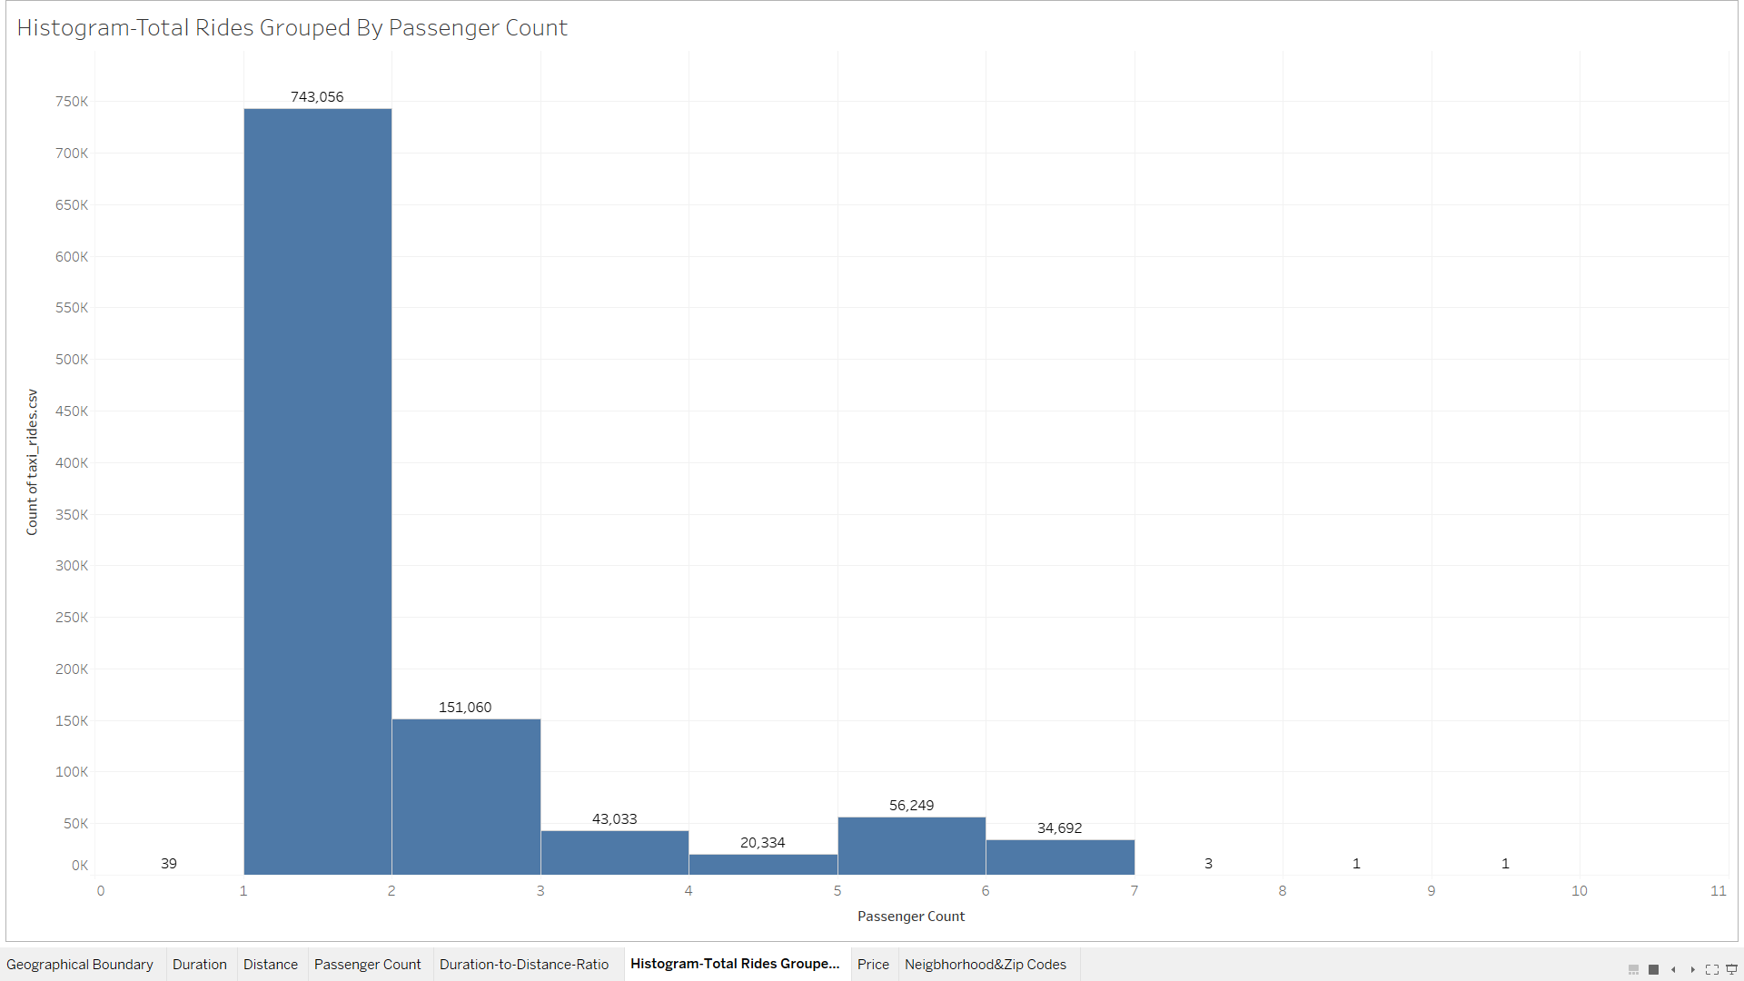
Answer Slide
(Fill out your answer here)

Slide 10
For the initial MVP launch (& most likely GA), we have a finite amount of monetary resources to build Flyber pick-up / drop-off nodes. We’ll need to be strategic on where we’ll place them:
Which neighborhoods/zip codes tends to experience a relatively higher density of pick-ups?
Which neighborhoods/zip codes tends to experience a relatively higher density of drop-offs?
Which neighborhoods/zip codes tends to have the highest duration-to-distance ratios, based on pick-up?
Which neighborhoods/zip codes tends to have the highest duration-to-distance ratios, based on drop-off?
For any of the neighborhoods identified, are there any potential areas within the neighborhood that are optimal for flying taxi pick-up / drop-off? What makes them suitable?
Questions - Analysis

Slide 11
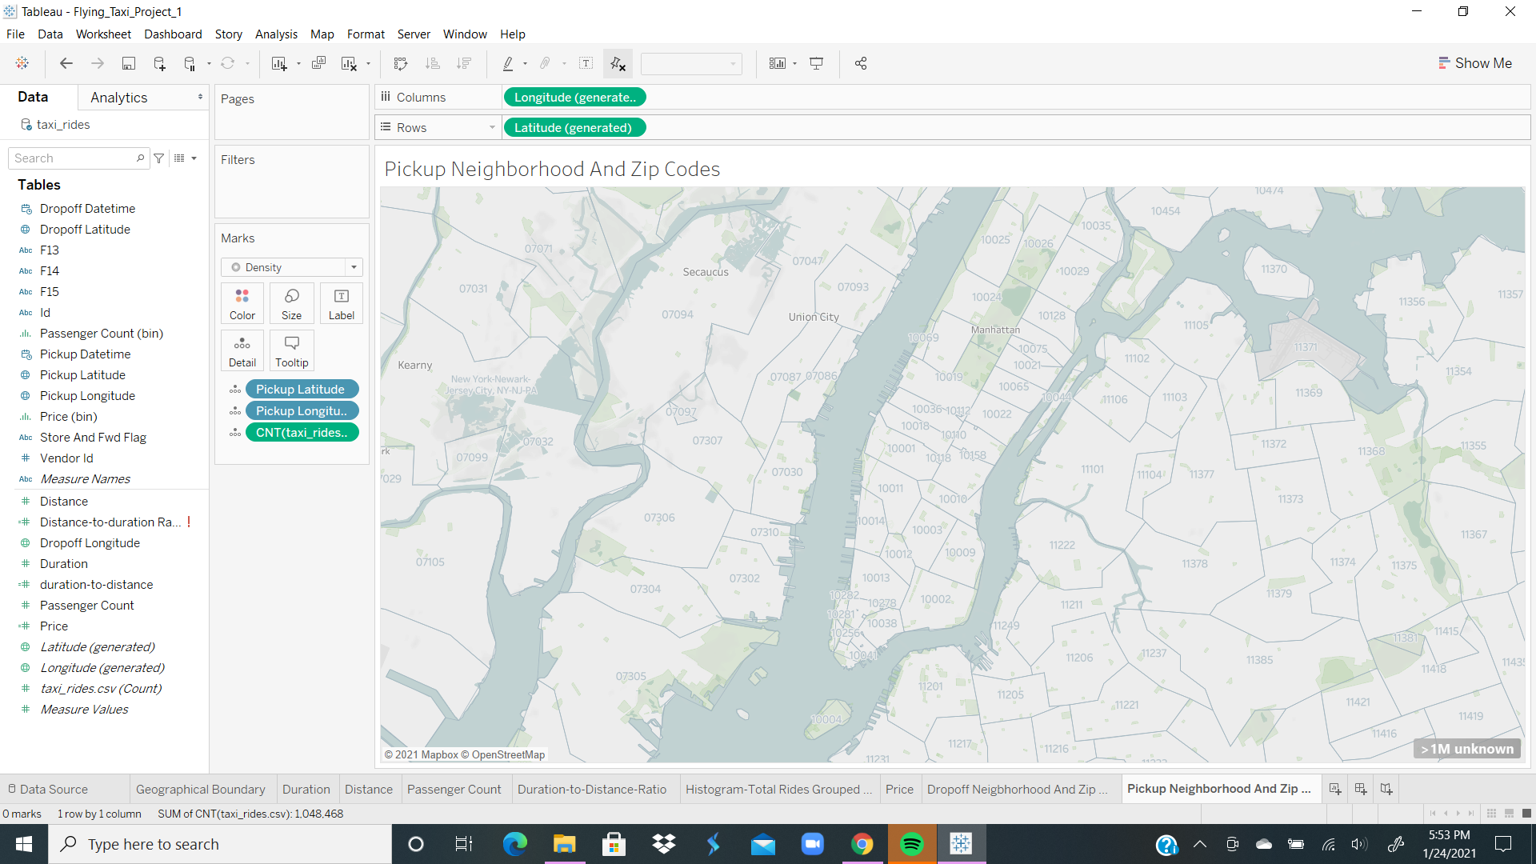

Slide 12
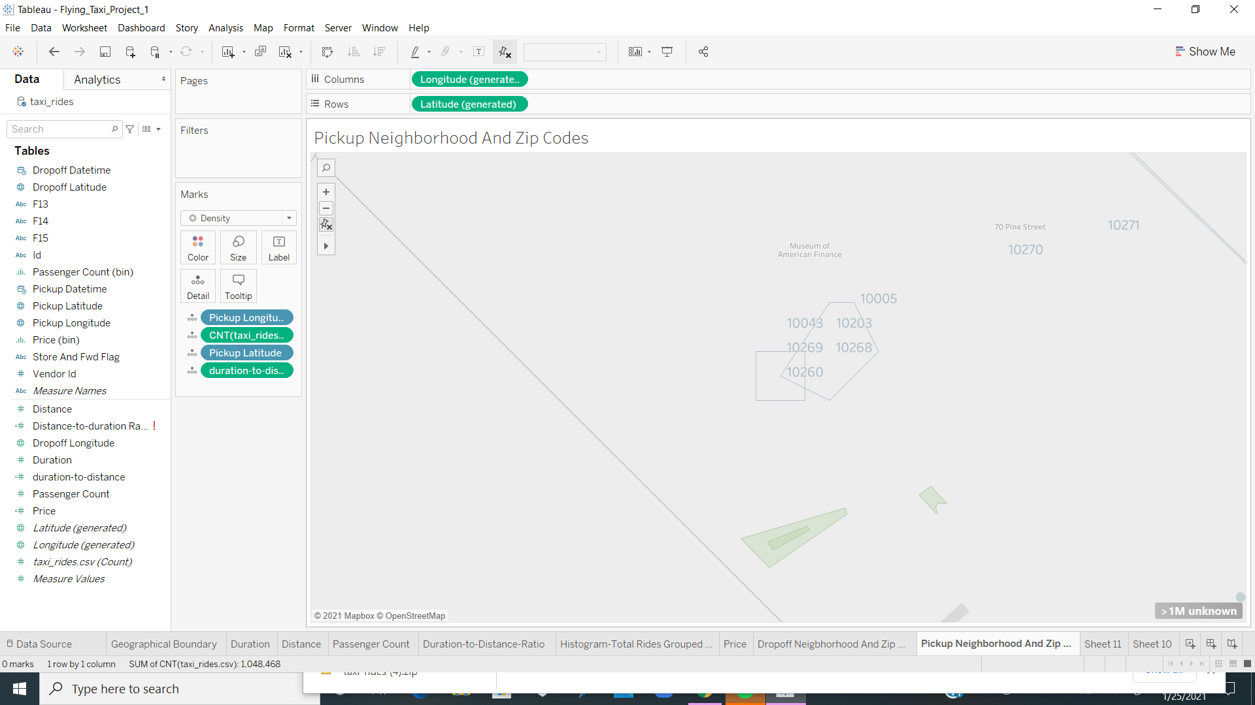

Slide 13
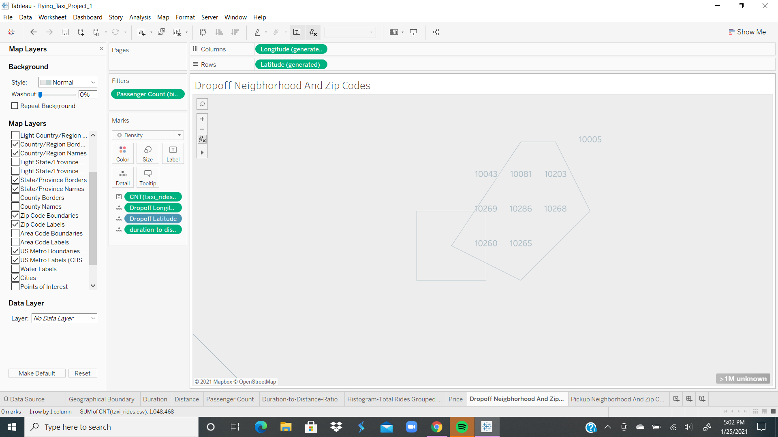

Slide 14
Answers - Analysis
The neighborhoods/zip codes that tends to experience a relatively higher density of pick-ups ⇒ 10043, 10203
The neighborhoods/zip codes that tends to experience a relatively higher density of drop-offs ⇒ 10043, 10081
The neighborhoods/zip codes that tends to have the highest duration-to-distance ratios, based on pick-up ⇒ 10260
The neighborhoods/zip codes that tends to have the highest duration-to-distance ratios, based on drop-off ⇒ 10260
Financial District will be suitable
The reason being the fact that the data supports higher pickups and dropoffs.

Slide 15
It may not make operational sense to have the service running 24/7, for now.
What times throughout the day experience relatively higher volumes of ride pick-ups?
What days throughout the week experience relatively higher volumes of ride pick-ups?
Pinpoint any periods throughout the year that experience trend fluctuation or seasonality around ride pick-up volumes. This will help us in our post-launch analyses to determine if any spikes or dips were influenced by seasonality or through actual feature adoption/regression.
Questions - Analysis

Slide 16
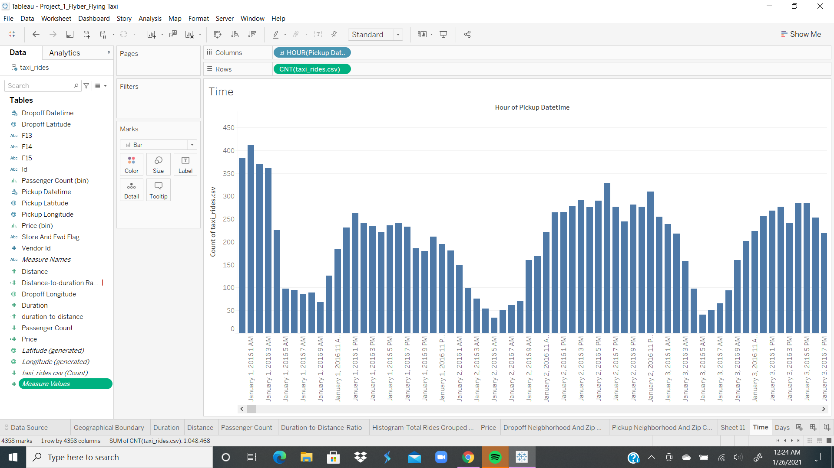

Slide 17
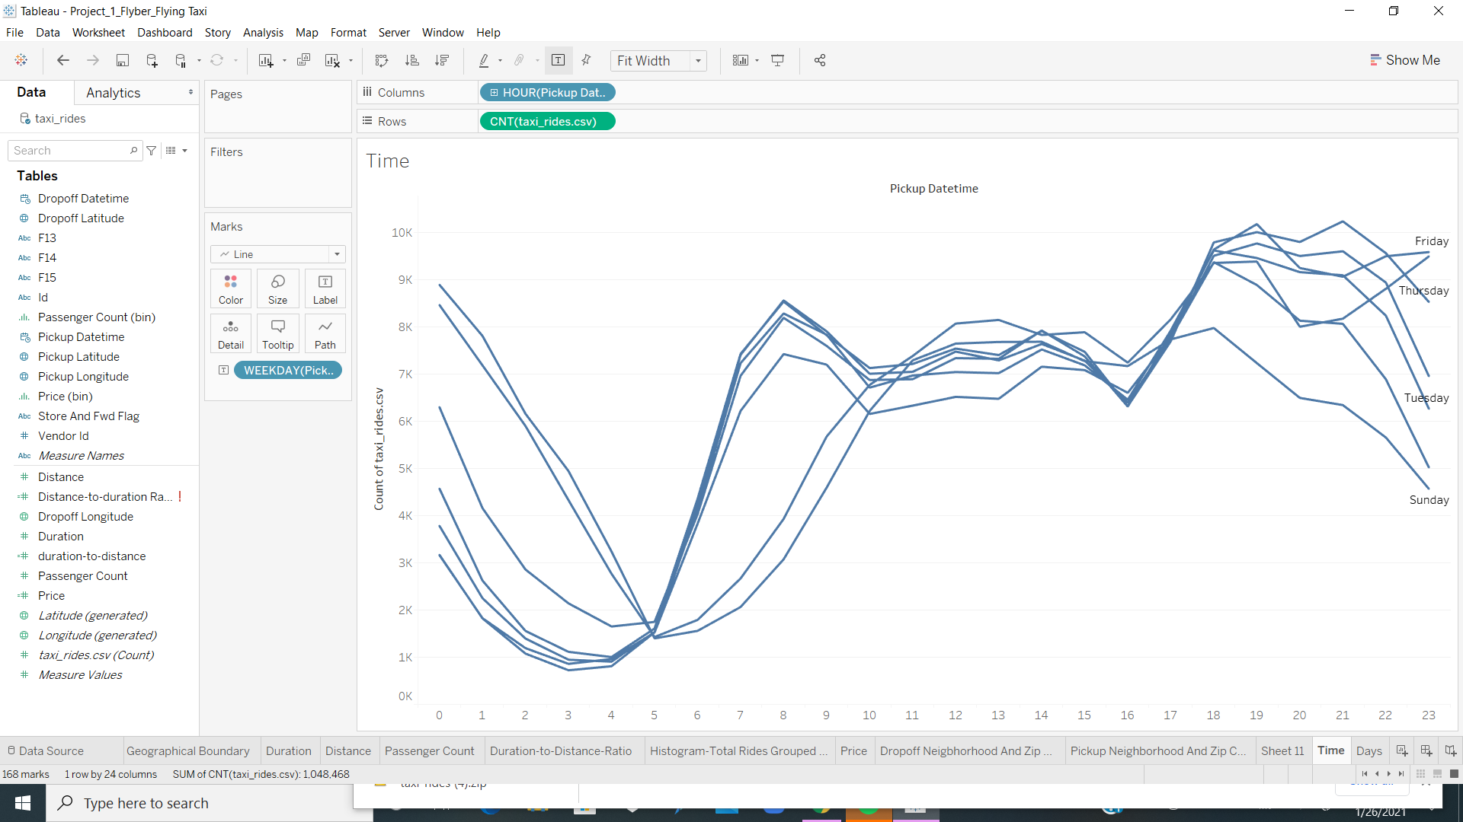

Slide 18
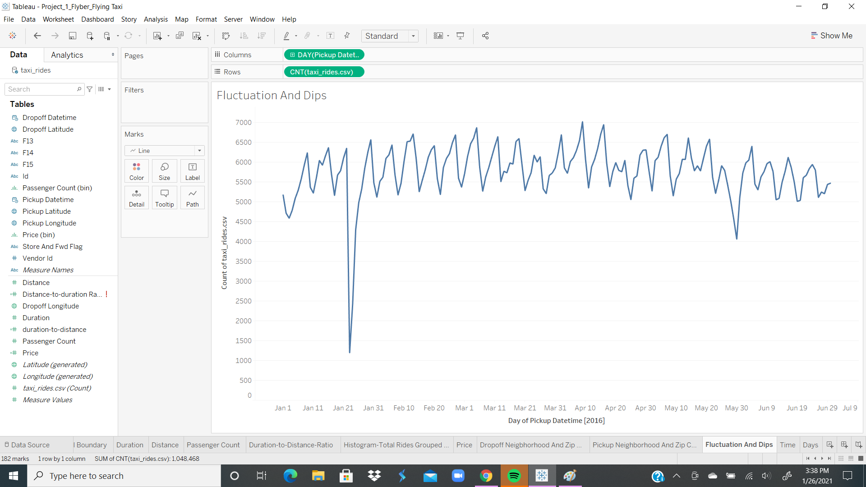

Slide 19
Answers - Analysis
The times throughout the day that experience relatively higher volumes of ride pick-ups are ⇒ 7.00 AM, 8.00 AM and 6.00 PM, 7.00 PM, 9.00 PM
The days throughout the week that experience relatively higher volumes of ride pick-ups are ==⇒ Weds, Thursday, Friday and Saturday
There is a dip (end of January, and early June )
Moderate Fluctuations around (February thru May)

Slide 20
Ensure the fields are parsed correctly, field headers are included in the first row of the CSV.
Question schema:
Q1 - What is your email?
Q2 - What gender do you identify as?
Q3 - What is your age?
Q4 - What is your annual income? (income bands)
Q5 - What neighborhood do you reside in?
Q6 - Do you currently use taxis? (Y/N)
Q7 - Do you currently use ridesharing services? (Y/N)
Q8 - Would you use a flying taxi service, if such a concept existed? (Y/N)
Q9 - If yes to Q8, how much would you be willing to pay per mile for such a service?
Q10 - If no to Q8, what is the reason?
Questionnaire - Gathering user feedback

Slide 21
For our future product marketing efforts, we’ll want to extract the following:
Is there an inclination of better Flyber adoption based on gender, age, income level, or neighborhood of residence?
What is the distribution of potential price per mile based on gender, age, income level, and neighborhood of residence?
What is the different personas/segments of negative sentiment towards not using a flying taxi car service?
Extracting Relevant Marketing Data

Slide 22
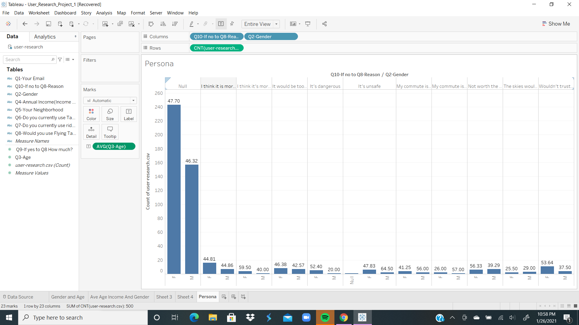

Slide 23
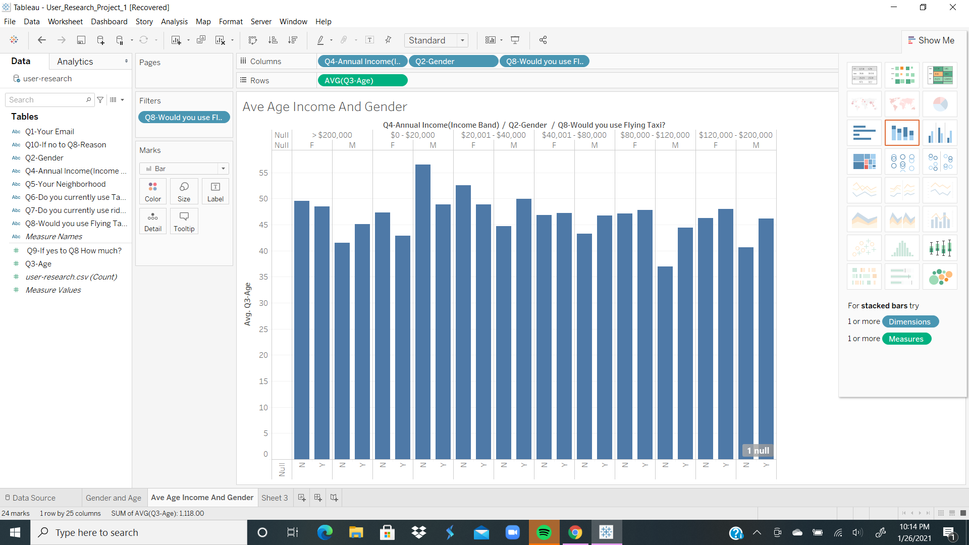

Slide 24
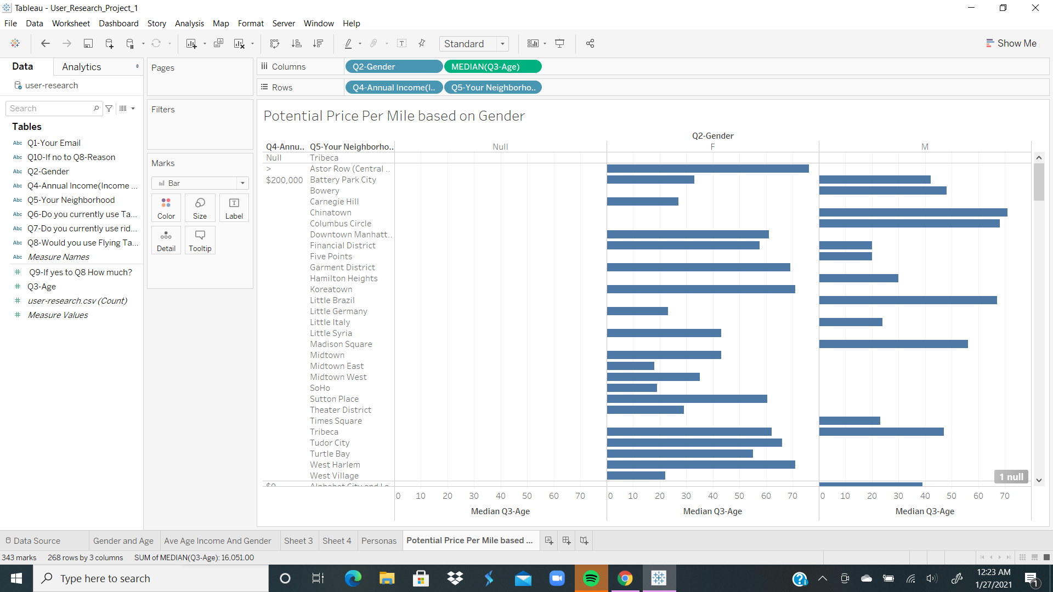

Slide 25
Answer Slide
Yes.
More Female than Male willing to take a Flying Taxi
More Ave Age 42 and above are willing to take a Flying Taxi
$40 to >$200,000 income category consistently willing to take Flying Taxi
$0 t0 $20,000 income category less willing to take Flying Taxi
Based on Annual Income, Median Price = $20
Range $12 to $35
Female Ave Age 44.81 to 53.64 are more likely to have negative sentiments towards using a Flying Taxi (scared, considered unsafe/too expensive)

